Slide 1


Slide 2
Review Macromolecules
Proteins → amino acids
Carbohydrates →sugars
  (monosaccharides, polysaccharides, glucose)
Lipids → fatty acids and a glycerol
Nucleotides → nucleic acids

Slide 3

Important?
Almost all chemical reactions in an organism are controlled by enzymes.
Without enzymes these reactions would go too slowly for life to exist.
Most processes in an organism consist of many reactions in sequence.
Each one is catalysed by a specific enzyme- one enzyme for one reaction.
no reactions? no life!

Slide 4
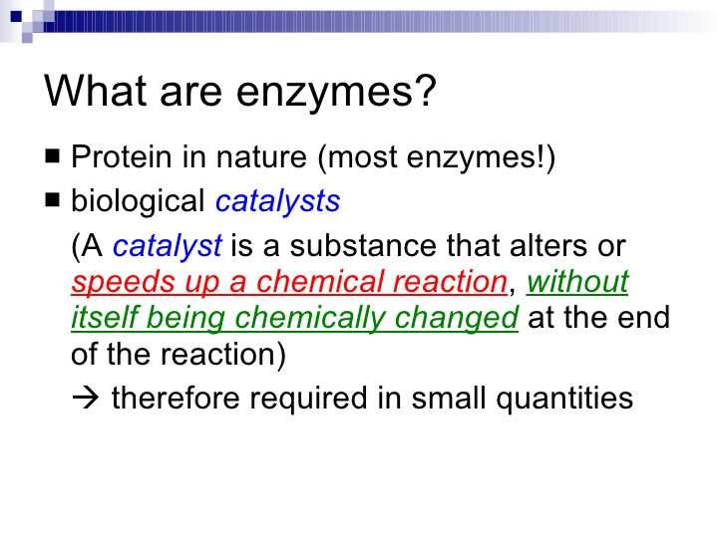

Slide 5
What do they do.. Essentially?
The Build molecules( Anabolic Enzymes) or they Break molecules down (Catabolic).
They provide an area in which a reaction can happen by actively forcing a reaction.
They can be used again and again

Slide 6
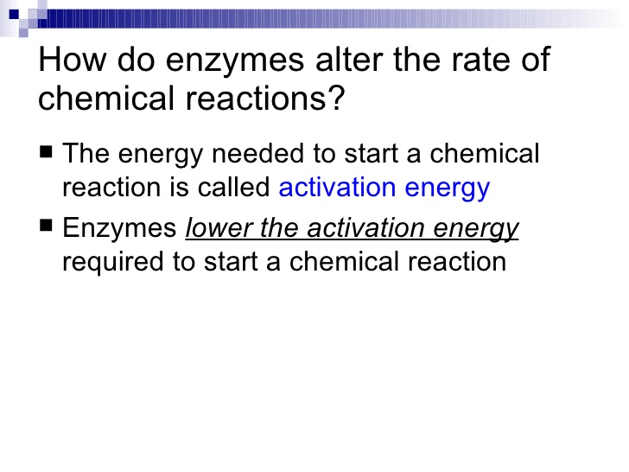

Slide 7
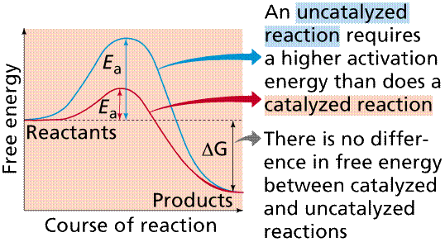
Activation Energy and Catalysis

Slide 8
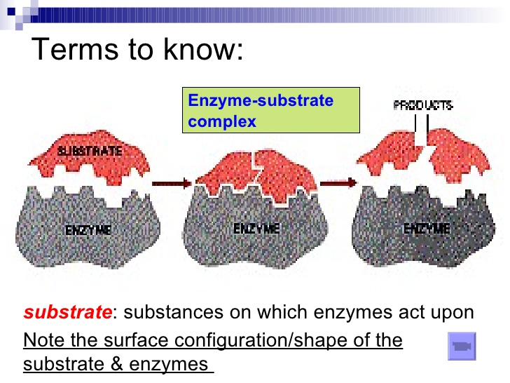

Slide 9
Essential Vocabulary
Active Site: Area on which an enzyme substrate binds.
Enzyme Specificity: enzymes will only catalyse one particular reaction.
Intracellular Enzymes catalyse reactions inside the cell.
Extracellular Enzymes catalyse reactions outside of the cell.

Slide 10
Factors that affect enzyme activity
Temperature
pH
Enzyme Concentration
Substrate Concentration

Slide 11
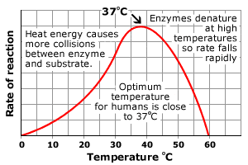
Temperature

Slide 12
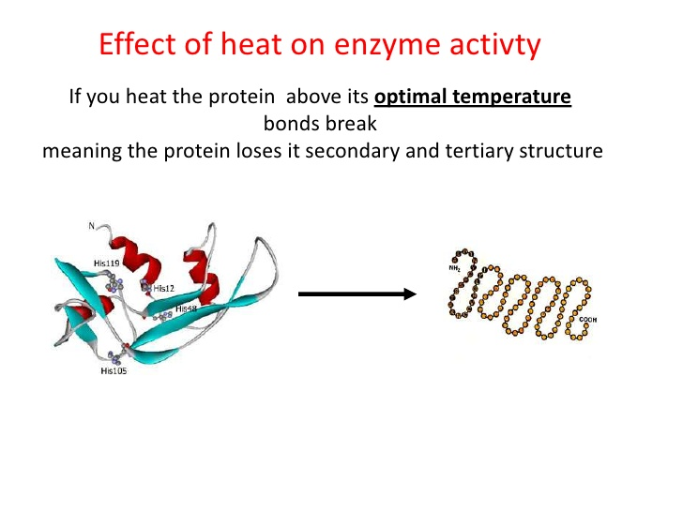
Denaturing Enzyme

Slide 13
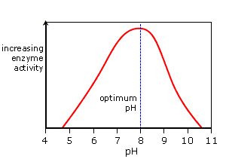
pH and enzymes
Changes in pH also alter an enzyme’s shape. Different enzymes work best at different pH values. The optimum pH for an enzyme depends on where it normally works. For example, intestinal enzymes have an optimum pH of about 7.5. Enzymes in the stomach have an optimum pH of about 2.

Slide 14
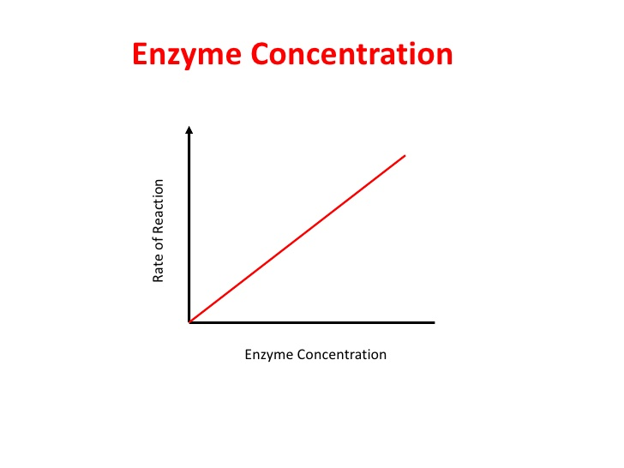

Slide 15
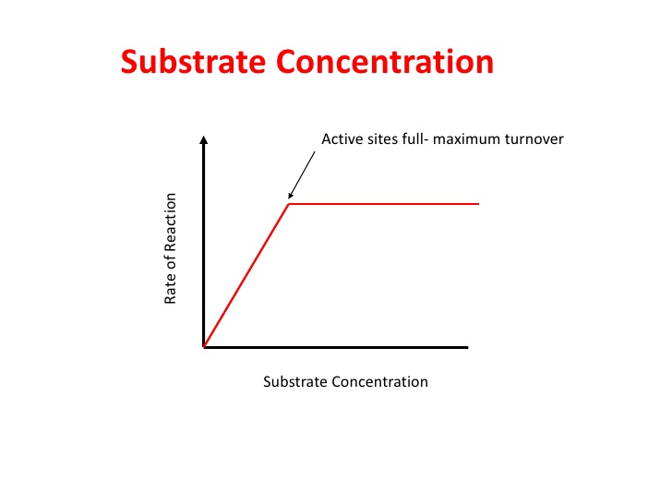

Slide 16
Define the following terms:
Anabolic reactions:
Catabolic reactions:
Metabolism:
Catalyst:
Metabolic pathway:
Specificity:
Substrate:
Product:
Reactions that build up molecules
Reactions that break down molecules
Combination of anabolic and catabolic reactions
A substance that speeds up reactions without changing the produced substances
Sequence of enzyme controlled reactions
Only able to catalyse specific reactions
The molecule(s) the enzyme works on
Molecule(s) produced by enzymes

Slide 17
Enzyme Action:
Lock and Key Model
An enzyme binds a substrate in a region called the active site
Only certain substrates can fit the active site
Amino acid R groups in the active site help substrate bind
Enzyme-substrate complex forms
Substrate reacts to form product
Product is released

Slide 18
Lock and Key Model
    + +
E + S ES complex E + P
P
S
S
P

Slide 19
Enzyme Action:
Induced Fit Model
Enzyme structure flexible, not rigid
Enzyme and active site adjust shape to bind substrate
Increases range of substrate specificity
Shape changes also improve catalysis during reaction

Slide 20
Enzyme Action:
Induced Fit Model
E + S ES complex E + P
P
S
S
S
P

Slide 21
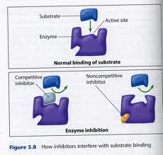
Competitive Inhibitors
An Enzyme Inhibitor is a substance that slows down an enzyme’s reaction in any way.
A competitive inhibitor blocks the active site used by the substrate. The enzymes cannot even catalyse the competitive reactions, because they have a specific shape
The change in shape that most competitive inhibitors cause, is reversible.

Slide 22
Co-Enzymes and Cofactors
Cofactor- A substance that help to control the rate of enzyme reactions. Some Cofactors are attached to the molecule, others aren't.
Coenzyme- Organic molecules that bind briefly to the active site before, or simultaneously with the substrate.
Coenzymes may be changed when the enzyme reaction is done, so cannot be reused.

